Slide 1
CRICKET’11 PLAYER AUCTION GAME Data Structure: Red Black Tree
Habib Al Hasan
Israk Entisar
Sheikh Asiful Islam

Slide 2


OBJECTIVE
IDEA
The game is all about to utilize the use of a specific algorithm
LANGUAGE
To use the Red-Black tree Algorithm
IMPLEMENTATION
In the world there are a lot ways to implement our way of thoughts.

Slide 3
BINARY TREE DATA STRUCTURE
A tree whose elements have at most 2 children is called a Binary Tree. Since each element in a binary tree can only have 2 children, we typically name them left child and right child.
BINARY SEARCH TREE
Binary Search Tree is a node based Binary Tree data structure. The left sub-tree of the BST root contains the lesser nodes comparing with the root or the previous node comprising with that the right sub-tree contains the higher nodes comparing with the root or the previous one. Both of the sub-trees must be a BST and there must not be duplicate nodes.
AVL
AVL Tree is a BST in which the difference of heights of left and right subtrees of any node is less tha or equal to one. There is a need to maintain the BST to be balanced of height, so that it is possible to obtain for the search option of log₂(N) time in the worst case. AVL trees are often compared with Red-Black trees because both of the trees support the same kind of operations and takes time for the basic operations. For lookup-intensive applications, AVL trees are faster than red-black trees because they are more strictly balanced. Similar to red-black trees, AVL trees are height-balanced. Both are not weight balanced and also not balanced by siblings those can have hugely differening numbers of descendants. The difference between both of the sub-trees must be less than 2. Re-balancing needs to be done when, heights of 2 child sub-trees of a node differs by more than one. Faster retrievals as strictly balanced.
RED-BLACK TREE
A Red-Black Tree is a BST in which each node is colored red or black whereas the root is always black. All null leaves are black, both of the children of red node are black. Every simple path from a given node to any of its descendant leaves contains the same number of black nodes. Self balancing of the nodes are provided if planting any of the colored nodes. When tree is modified, new tree is subsequently rearranged and reprinted. It requires 1 bit of color information for each node in tree. Path from root to farthest leaf is no more than twice as long as path from root to nearest leaf.

Slide 4
DIFFERENCE AMONG BST, AVL TREE, RED-BLACK TREE
This is not a self balancing tree
This is able to form long chains of nodes that can cause searches to take linear time.
Insertion and deletion is the most slowest among red-black tree and AVL tree.
AVL tree is a strictly self balancing tree.
This can search any node faster than all other trees.
Insertion and deletion is very much slow than Red-Black tree but faster than BST
Red-Black Tree is a self balanced tree.
Red-Black Tree takes a logarithmic time to search
This provide insertion and deletion operations much faster than others.
BST
AVL TREE
RED-BLACK TRRE

Slide 5
INSERTION
Case1: If tree is empty, create new node as root with color “Black.”
Case3: If parent of new node is black then exit.
75
Case4(I): If parent of a new node is red, then check the color of parent sibling of new node. If color is black or null then do suitable rotation and recolor the nodes.
Case2: If tree is not empty, create new node as leaf node with color red.
75
75
Grandparent/Root
28
28
LL Rotation
28
Children of new node
11
11
75
Now this is a Red-Black Tree

Slide 6
28
Insert 40:
28
11
75
11
75
Parent
40
40
New Node
A Perfect Red-Black Tree
Insert 90:
Case4(II): If color is red then recolor and also check if parents parent of new node is not red node then recolor it and recheck.
28
11
75
NULL
NULL
40
90
NULL
NULL
NULL
NULL

Slide 7
Deletion
Case1: Perform a BST Deletion
Case2: if node to be deleted is red just delete the node.
Case3: If root is double black, just remove double black.
Deleting 55:
50
50
20
65
20
65
15
25
55
70
15
25
N
70
NULL
NULL
NULL
NULL
NULL
NULL
68
80
NULL
NULL
NULL
NULL
68
80
NULL
NULL
NULL
90
NULL
NULL
90
NULL
NULL
NULL
NULL
NULL

Slide 8
Case4(I): If double black sibling is black ____ both if children are black.
Remove Double Black.
Add Black to its Parent
If Parent is Red it becomes black
If Parent is Black then it becomes Double black.
Make Siblings Red.
Case4(II):If Double Black sibling is Red , swap colors of parent and its siblings. Rotate Parent in Double Black direction
50
Double Black Exists! Apply Case4 now…
50
20
65
20
70
15
25
68
70
N
15
25
65
80
NULL
NULL
NULL
NULL
68
80
NULL
NULL
NULL
NULL
NULL
90
NULL
NULL
90
NULL
68
68
NULL
NULL
N
NULL
NULL
NULL
NULL

Slide 9
Case6: Double Black sibling is Black . Sibling child who is far from Double Black is black but near child to double black is red.
Swap the Color Double Black sibling and Siblings Child.
Rotate opposite direction of Double Black
Case7: Double Black’s sibling is Black, for child is red.
Swap colors of parent and sibling
Rotate parent in Double Black direction
Remove Double Black
Change color of Red child to Black which is far from Double Black
50
20
70
15
25
65
80
90
NULL
NULL
NULL
NULL
NULL
68
NULL
NULL
NULL
NULL

Slide 10
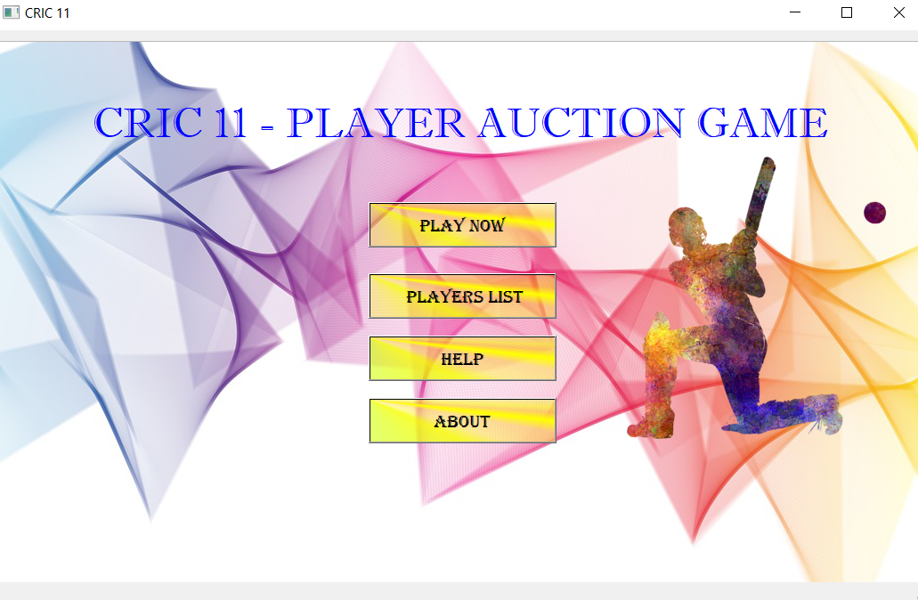

Slide 11
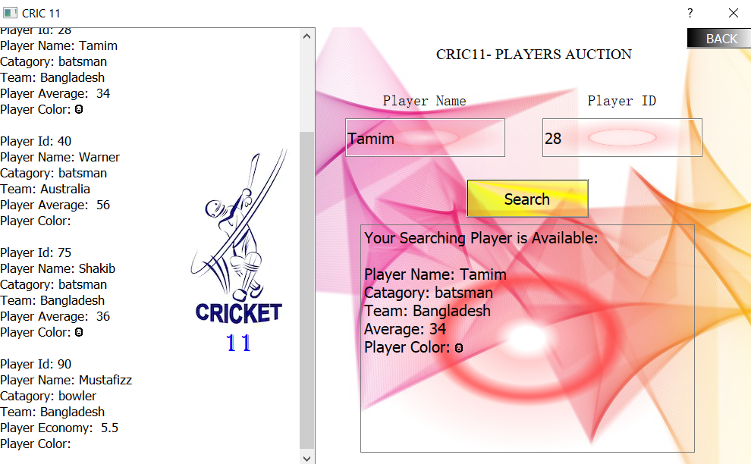
Here we can see the player draft list where we can find out any player by searching. In this part we can also make the list of the players so that which one to buy at first and which one at the very end.

Slide 12
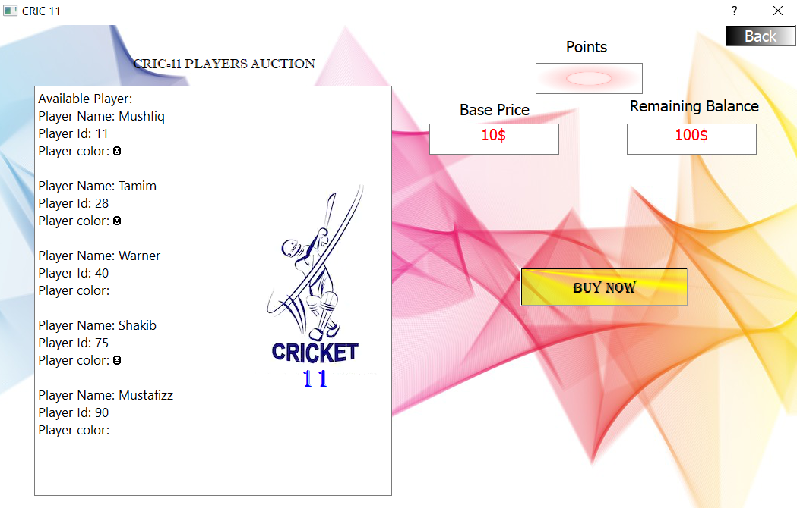
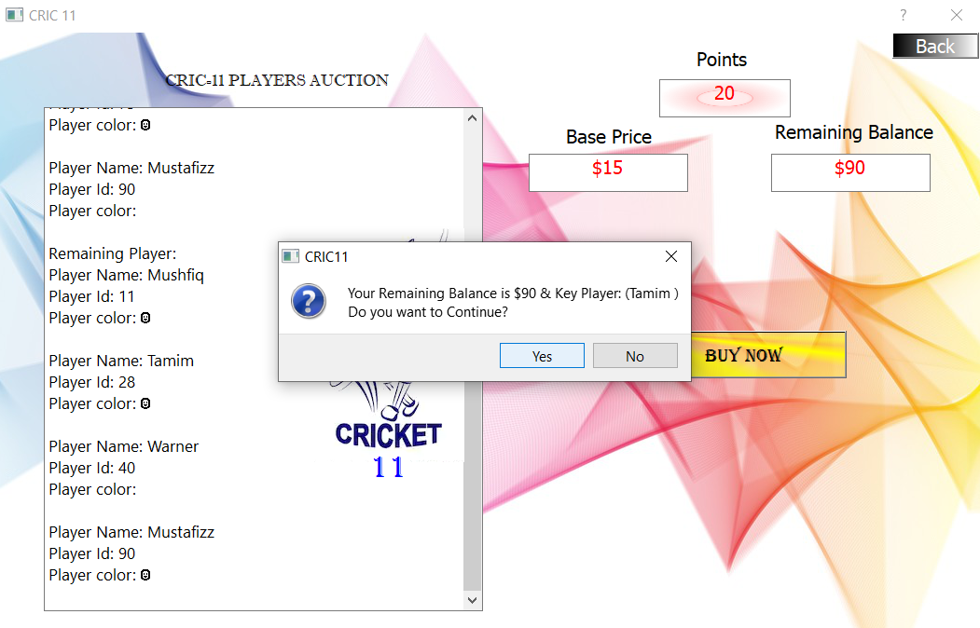
At first from the main menu when we will click on the play now button we will enter the auction game where there will be some players draft present.
When I will press buy now button to start the auction I will be able to buy players from the player draft.
There is a limitation and that is I will have a fixed amount of money that I can use to buy players.
Every starting player will have a base price, which will be changed after a player has been bought.
If I want to win the game then I will have to buy each and every player with the given amount of money. If my money passes out before all the playes have been bough then I will lose the game.
The player who will be in the root if the root gets double blacked then the player will be the key player with the largest base price.

Slide 13

REAL WORLD APPLICATION
So, till now we have got the knowledge of red-black tree theory and the implementation of the red-black tree through a project. One may ask us, “Is this useful?”. In fact it is pretty useful in real life. For example in a process schedule or for keeping track of the virtual memory segments for a process. They are also commonly used in mapping, multi-mapping, multiset from C++ STL, Java.util.TreeMap, Java.util.TreeSet. Just like this there are more ways to bring this to the real world. As like this project in real life we have different type of auctions where we can use red-black tree algorithm to make the auction part very much easy . So as this also can be used in the stock market to make every stock incremented by every chance.
It is possible dear!

Slide 14
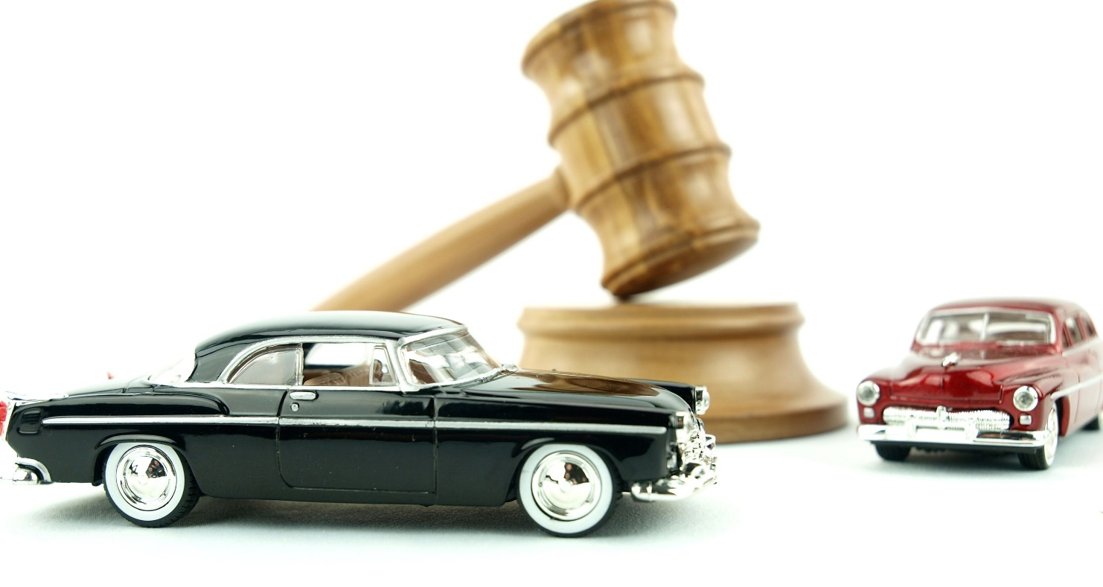







Slide 15


